Slide 1
MatchUp
A sports based social integration application

Slide 2
Introduction
MatchUp is a social integration application which allow users to:
Meet like minded peers
Live chat with other users
Create and edit personal profiles
Maintain a healthy lifestyle
With the use of technologies such as
Android studio
Java
Firebase

Slide 3
Motivation
People not knowing others who interested in the same sport
All similar technologies only available on one platform
Relationship between teens who use technology and teens who are obese
Technology and exercise seen as two polar opposites
What if both were combined?

Slide 4
Aims
Use current technology to promote healthy social and exercise based interaction
Technical specification
‘Must have’ requirements
‘Should have’ requirements
‘Could have’ requirements
User acceptance criteria

Slide 5
Solution Approach
Problem articulation and literature review produced 2 potential solutions
#1 Event planning application
Similar to those on the market
Help users organise sporting events
#2 Social matching application
Help users find people who share the same interests
Allow them to interact and create events to attend
Chosen solution #2

Slide 6
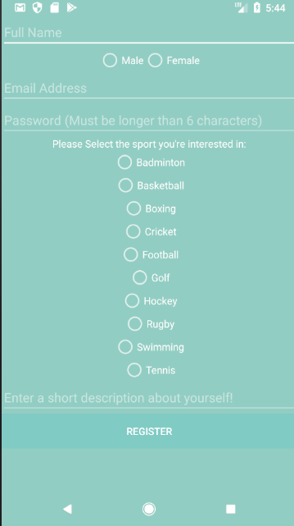
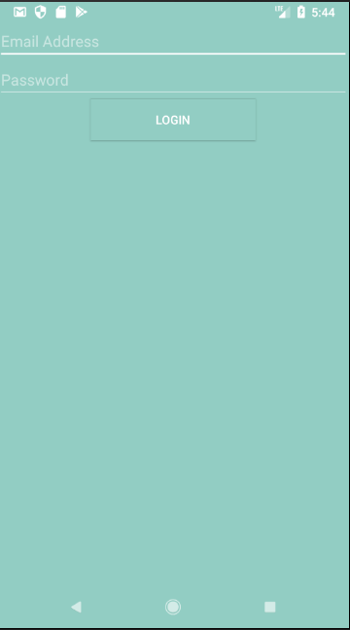
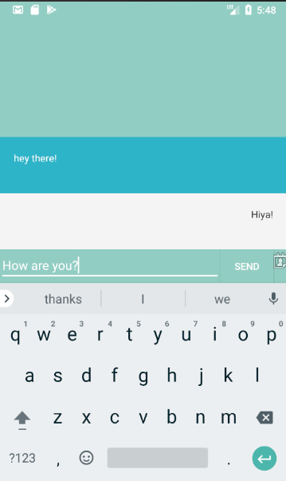
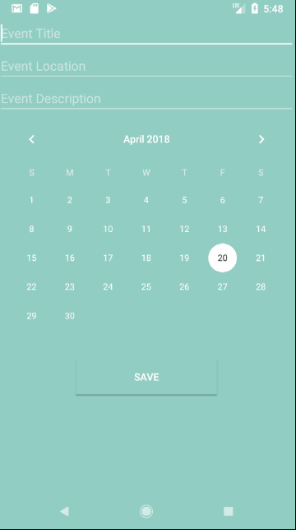
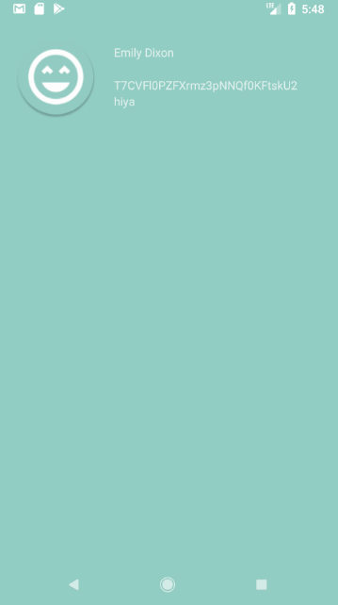
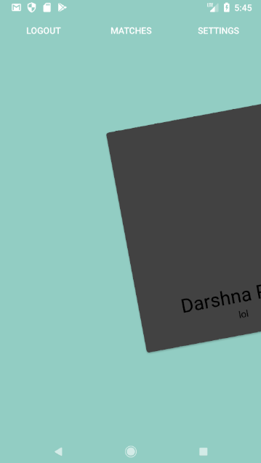
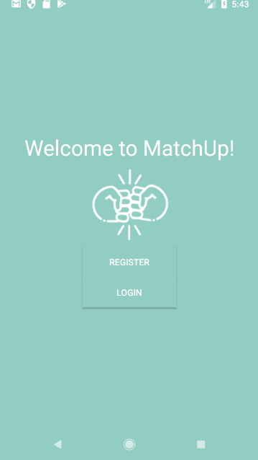
Implementation
Log in and registration
Swipe cards interaction
Live chat
Event creation
User profile settings
Implementation problems

Slide 7
Outcome
Problem solved to a certain extent
Promotes social interaction with like minded peers
Promotes exercise with friends made
Available on a platform that others weren’t
Technical specification and User acceptance criteria (mostly) met

Slide 8
Reflection
Improved project management skills
Developed technical skills
Project constraints got the better of me in some cases
Performance would have been improved with better time management
Better understanding of the requirements for a successful project

Slide 9
Conclusion
The combination of technology and sport is possible
Potential for future development
Revisit location feature
Integration of activity tracker
Group chats
Overall

